Slide 1
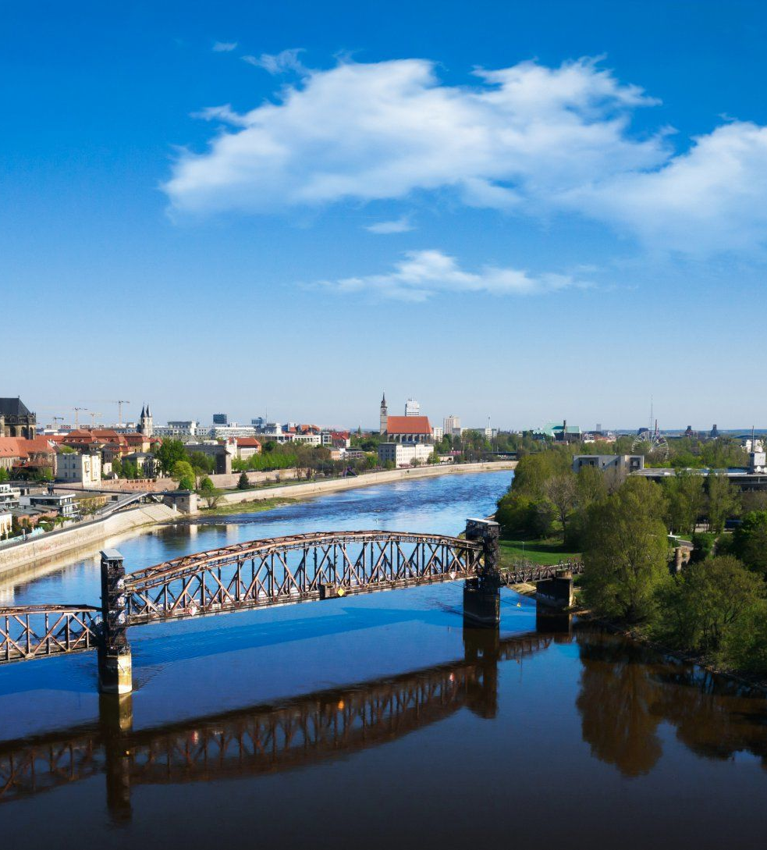
Simulation Project: Team Tetrahedron
Milestone #8 - Final Report
Image source: https://cdn.ottopix.de/wp-content/uploads/2019/04/Magdeburg-Panorama-%C3%BCber-der-Hubbr%C3%BCcke.jpg

Slide 2
Agenda
Simulation Project - Team D
Milestone #8 - Final Report
01
02
Project retrospective
Experiments
Milestone overview and highlights
Main experiments and their results
03
04
Recommendations
Overview of spending
Recommendations and their statistical significance
Statement of profit

Slide 3
01
Project retrospective
Simulation Project - Team D
Milestone #8 - Final Report
What was accomplished in each milestone, difficulties encountered, and problems solved

Slide 4
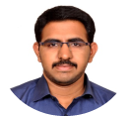
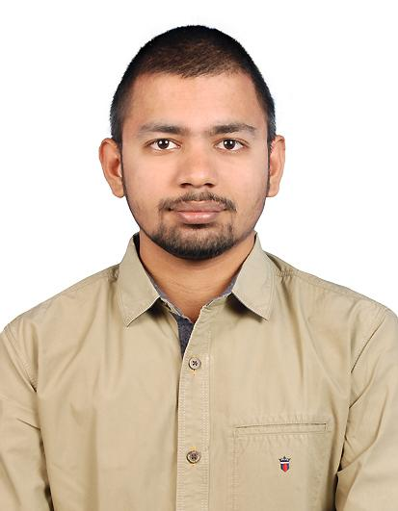
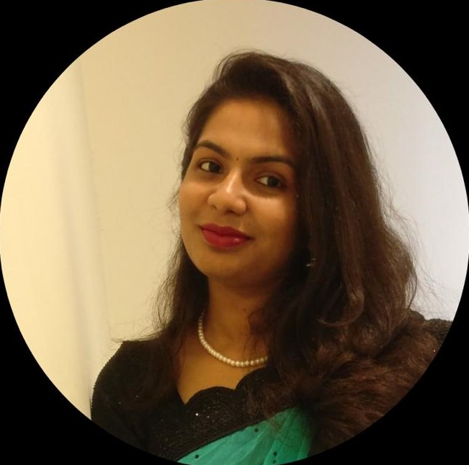
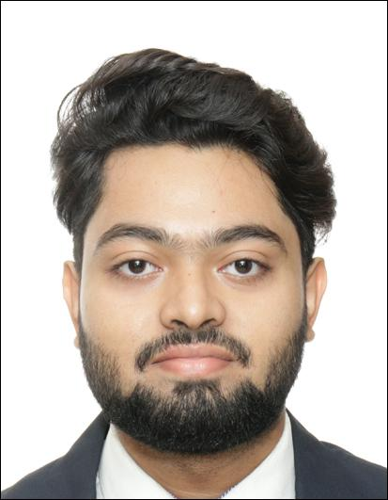
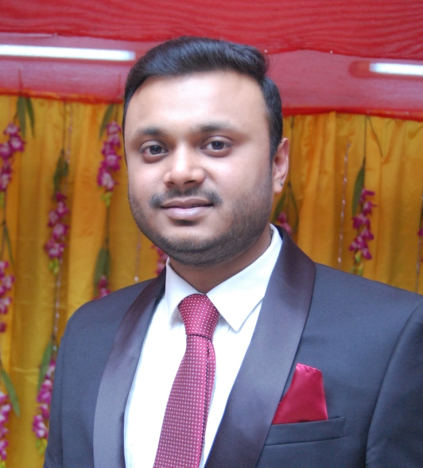

Team presentation
Simulation Project - Team D
Milestone #8 - Final Report
Lauro Fialho Müller
Team leader
Chandan Radhakrishna
Conceptual Model
Raghava Vinaykanth Mushunuri
Input Data Analyst
Kavya Vajja
Chief Software Architect
Anjan Chatterjee
Validation and Quality Control
Arnab Das
Experiment Designer
Team presentation
Planning
Conceptual model
Data analysis
Simulation program
Validation
Experiments
Final report

Slide 5
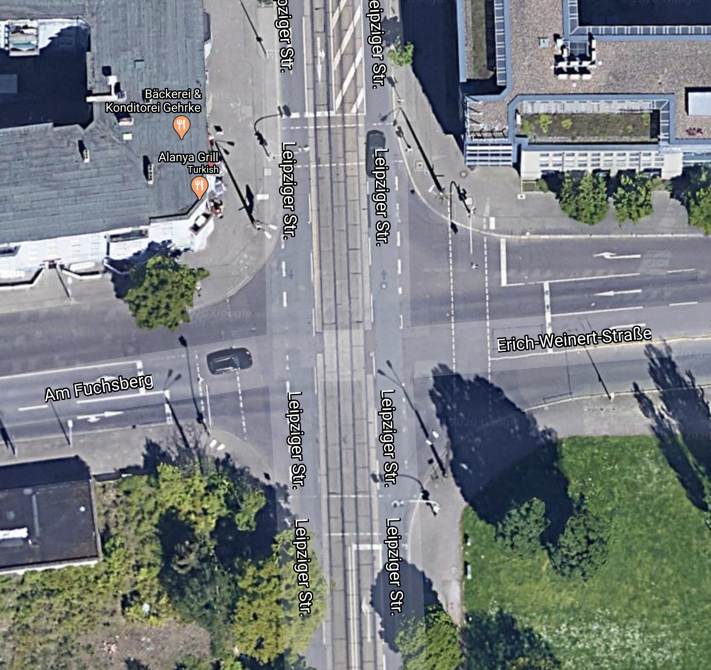
The intersection
Simulation Project - Team D
Milestone #8 - Final Report
#3
#1
Traffic may turn in all directions
#2
Presence of tram traffic
#2
#1
#3
Traffic flow constraints

Slide 6
Planning
Simulation Project - Team D
Milestone #8 - Final Report
Divide milestones into work packets
Assign work packets to team members
Estimate cost and duration of work packets
Team presentation
Planning
Conceptual model
Data analysis
Simulation program
Validation
Experiments
Final report

Slide 7
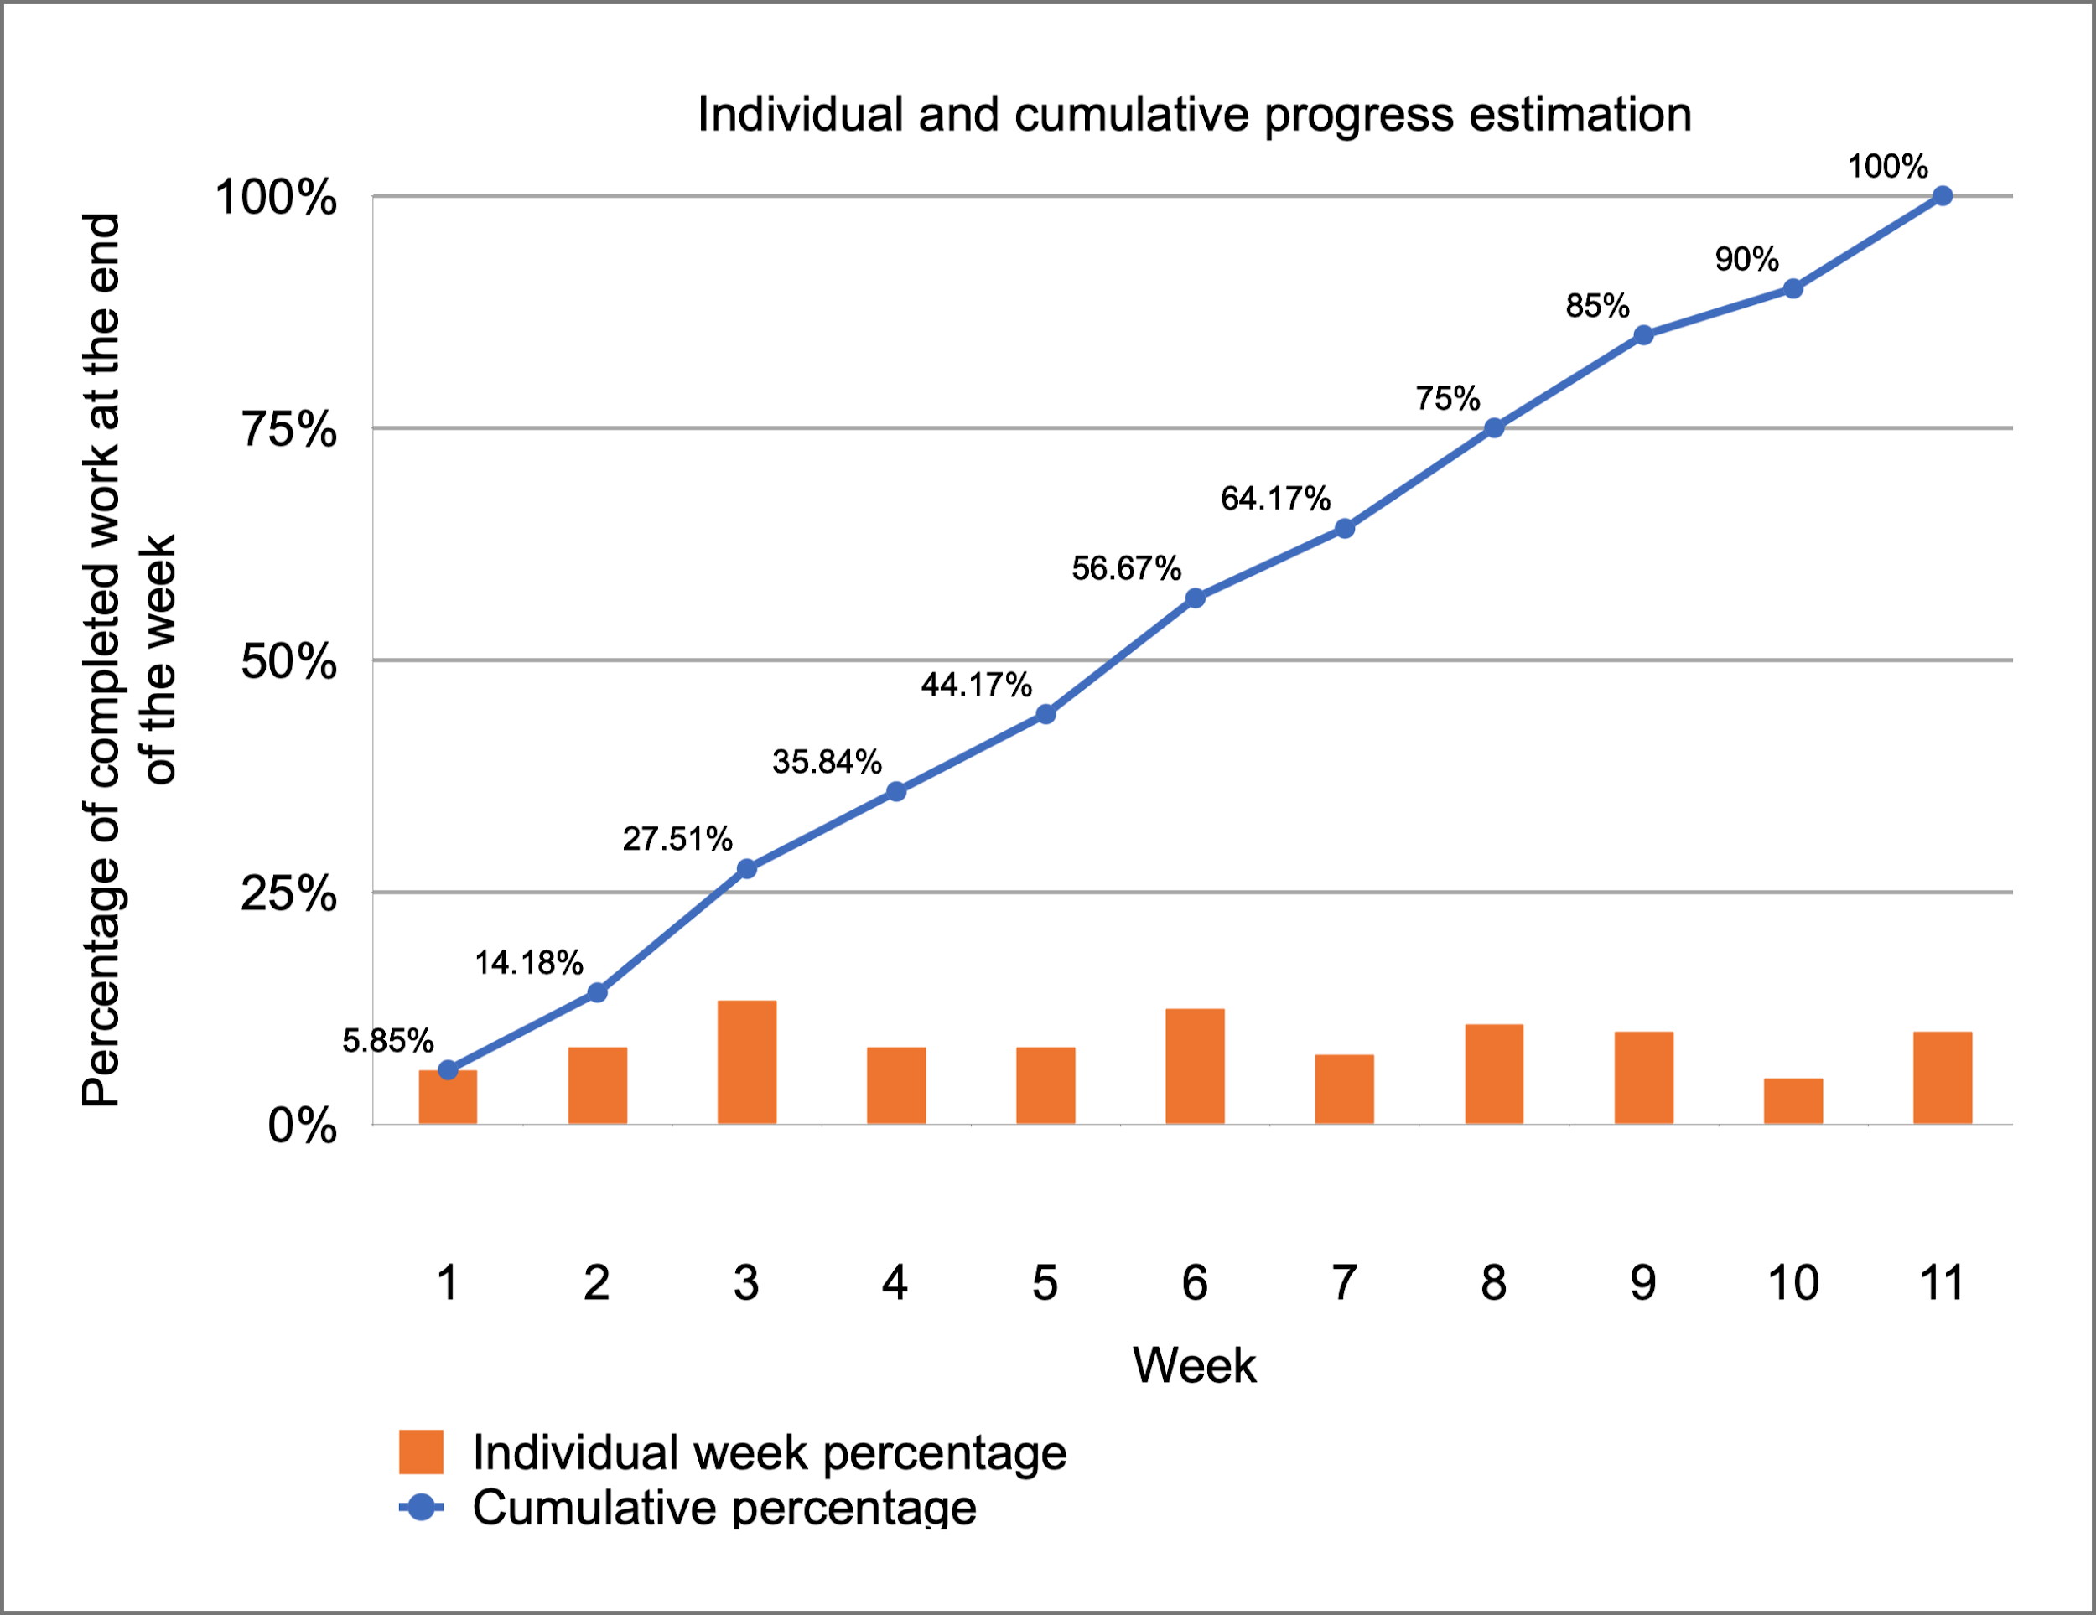
Planning
Simulation Project - Team D
Milestone #8 - Final Report
M. 1
M. 2
M. 3
M. 8
M. 7
M. 6
M. 5
M. 4
5.85%
8.33%
13.33%
8.33%
8.33%
12.50%
7.50%
10.83%
10.00%
5.00%
10.00%

Slide 8
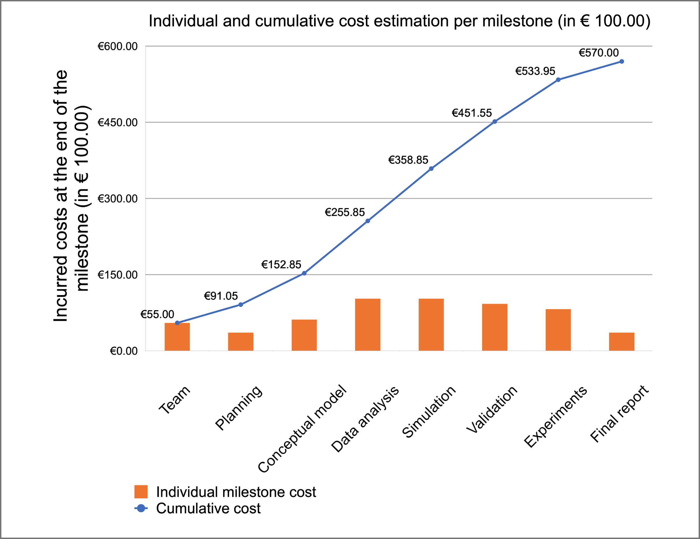
Planning
Simulation Project - Team D
Milestone #8 - Final Report
Buffer of
€ 3000.00
€55.00
€36.05
€61.80
€103.00
€103.00
€92.70
€82.40
€36.05

Slide 9
Conceptual model
Simulation Project - Team D
Milestone #8 - Final Report
Design a Stochastic Petri Net to represent the intersection
Two submodels, one for each major direction
Complex constructs to realistic represent the node behavior
Team presentation
Planning
Conceptual model
Data analysis
Simulation program
Validation
Experiments
Final report

Slide 10
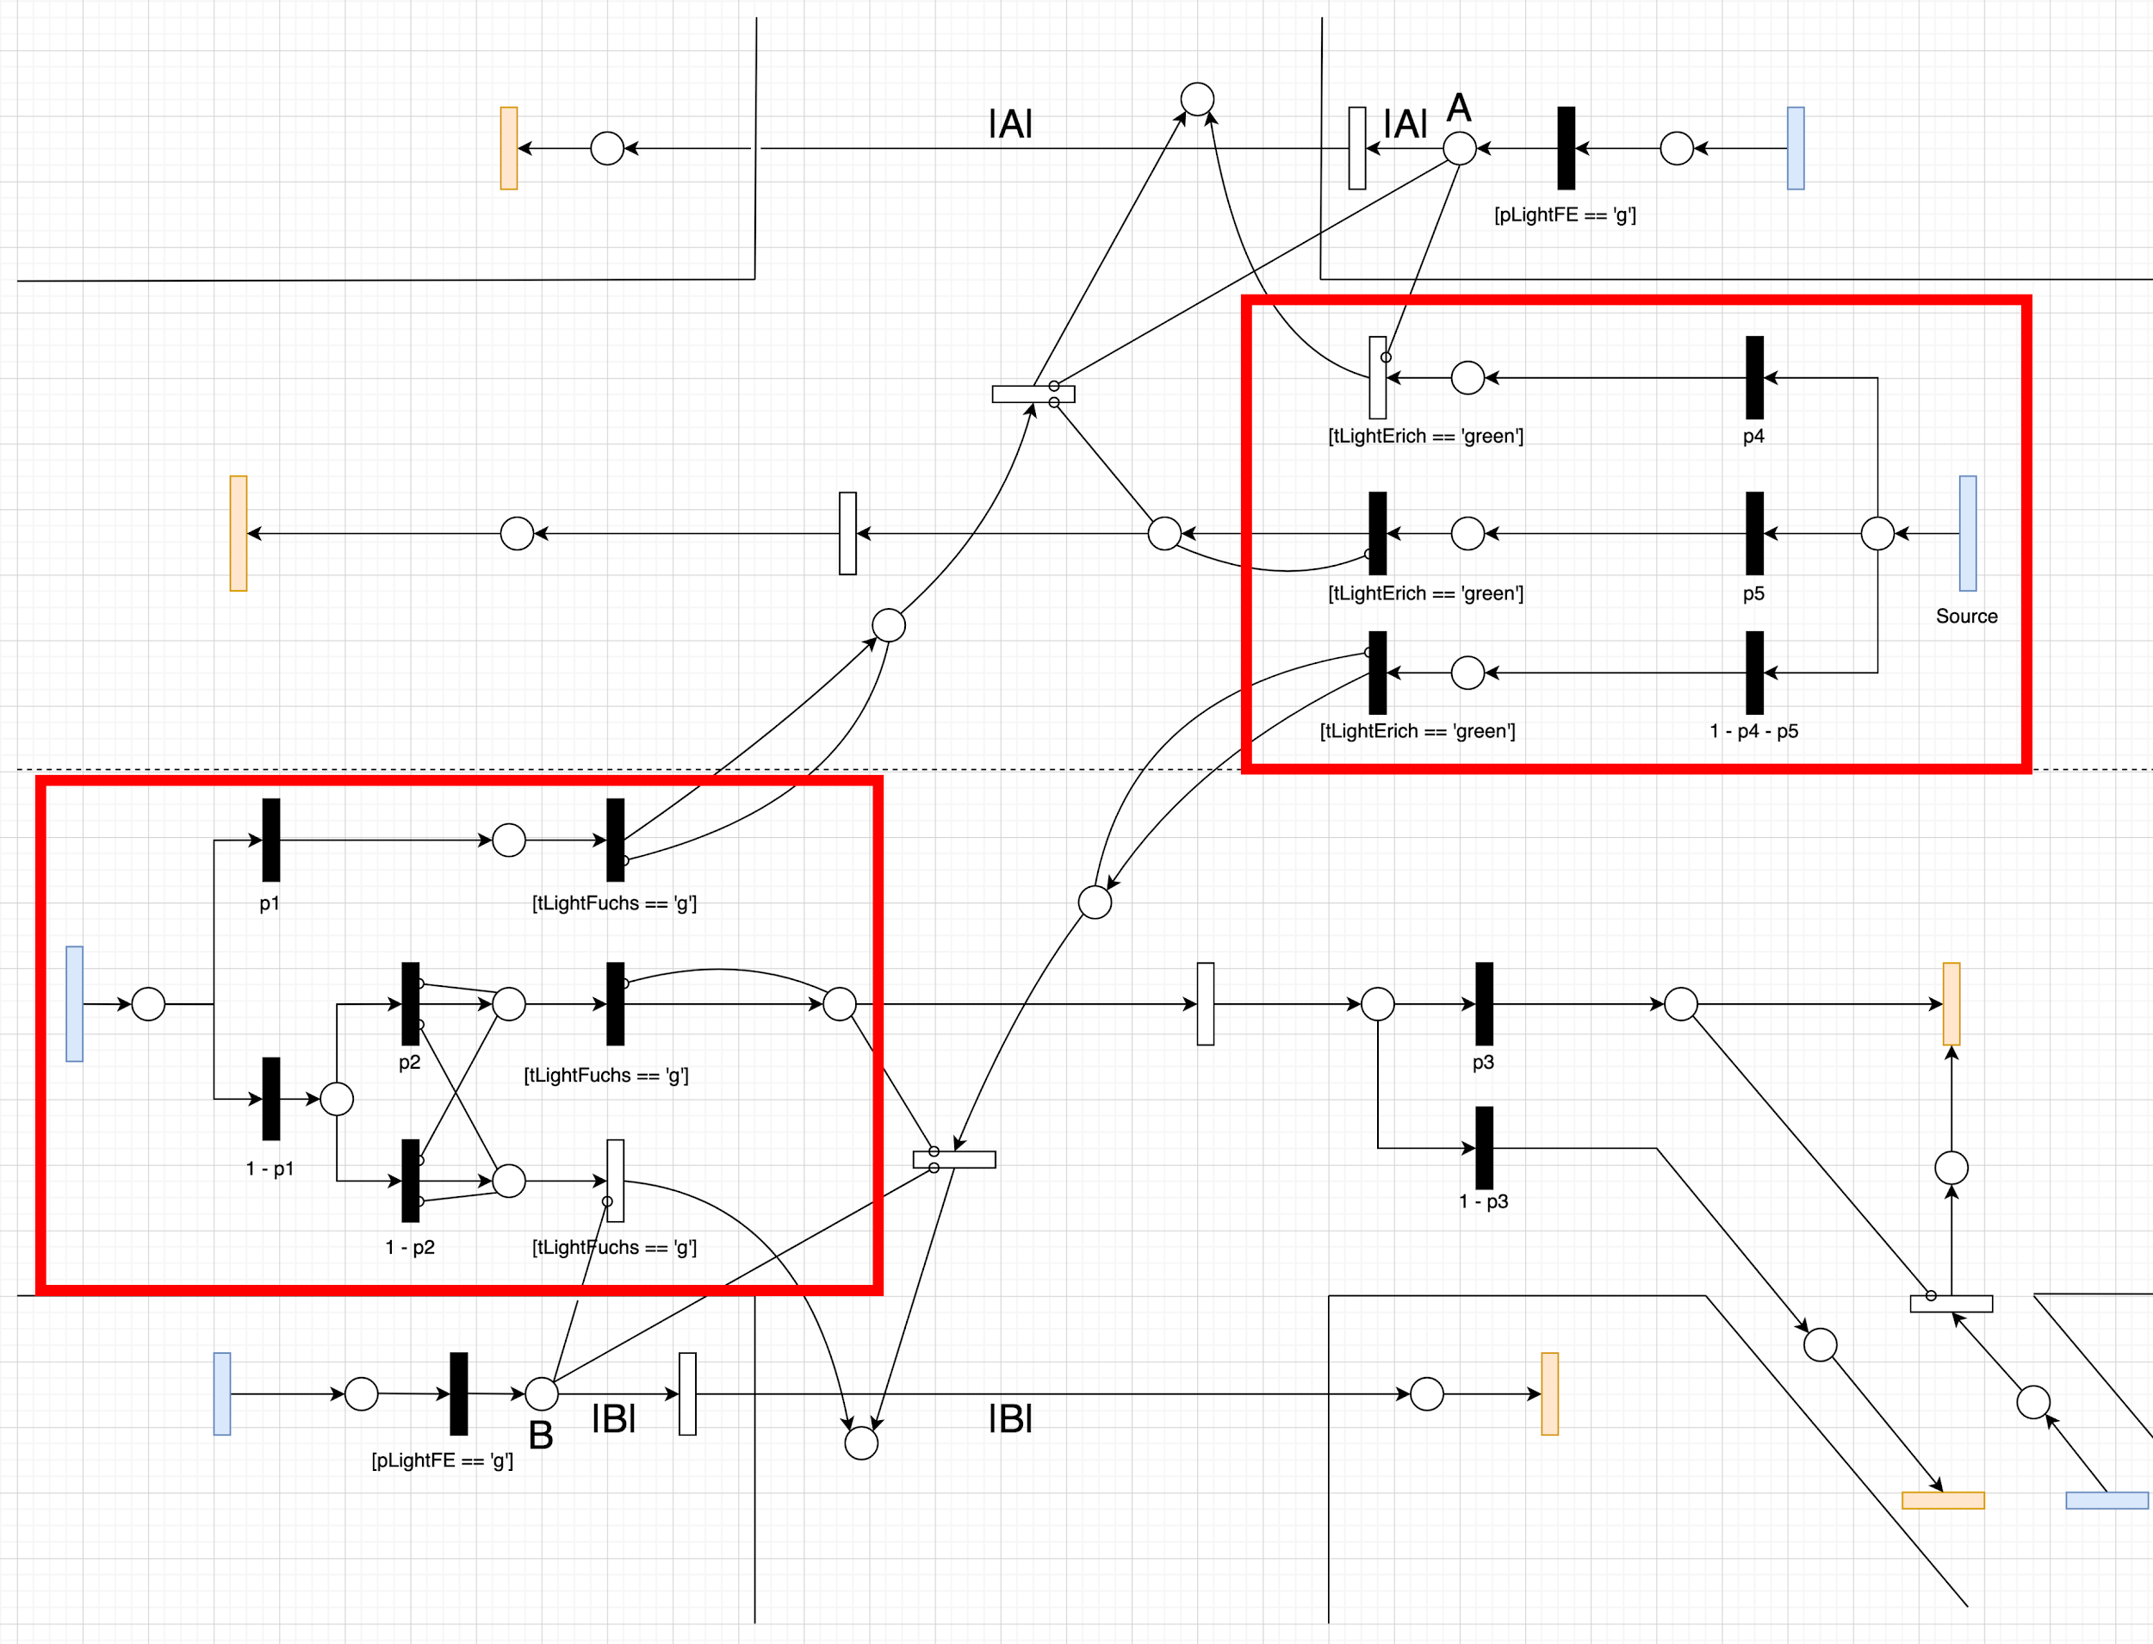
Simulation Project - Team D
Milestone #8 - Final Report
Cars in individual lanes following well-defined directions
Cars in multiple directions sharing the same lane

Slide 11
Data analysis
Simulation Project - Team D
Milestone #8 - Final Report
Vehicle and pedestrian interarrival distributions
Traffic phases
Vehicle turning probabilities
Team presentation
Planning
Conceptual model
Data analysis
Simulation program
Validation
Experiments
Final report

Slide 12
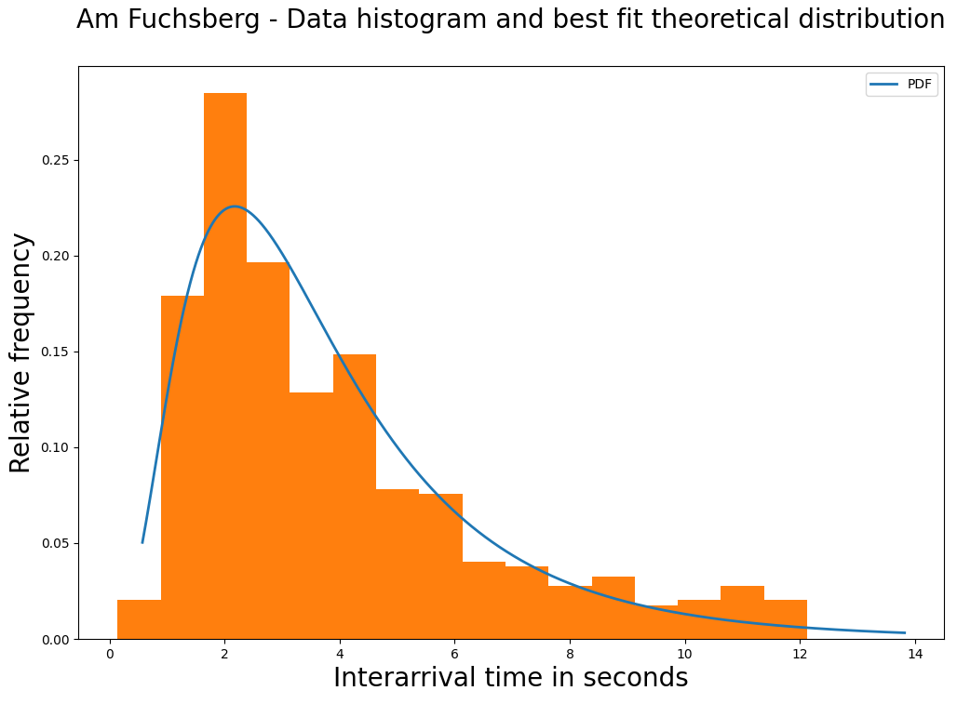
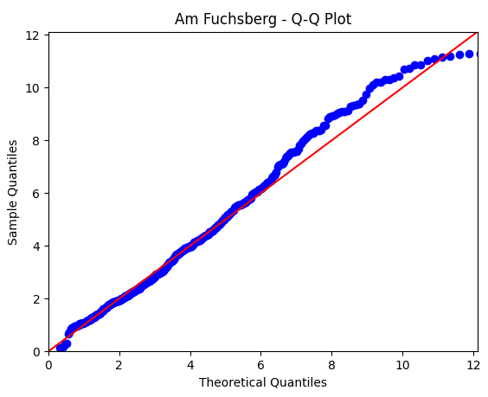
Data analysis
Simulation Project - Team D
Milestone #8 - Final Report
Am Fuchsberg: Histogram and best-fit theoretical distribution
Am Fuchsberg: Q-Q plot

Slide 13
Simulation program
Simulation Project - Team D
Milestone #8 - Final Report
Multiple complex constructs to fine tune agent behavior
Super / sub class structure to modularize the application
Parameters and variables instead of hard coded values
Team presentation
Planning
Conceptual model
Data analysis
Simulation program
Validation
Experiments
Final report

Slide 14
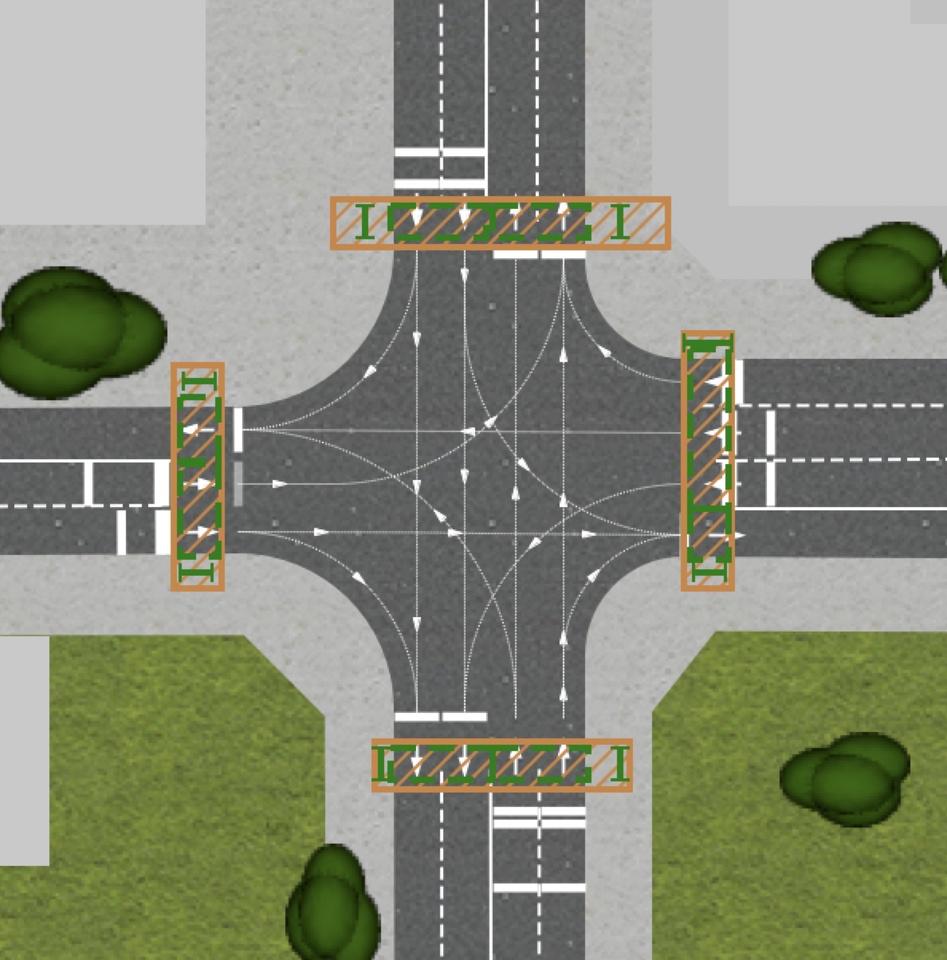
Simulation program
Simulation Project - Team D
Milestone #8 - Final Report
#1
Fine tuning of vehicle direction through individual roads and agent parameters
#1
#2
Multiple stop lines to handle complex interactions / behaviors
#3
#3
Pedestrian-specific constructs in order to simulate reality more closely
#2

Slide 15
Validation and quality control
Simulation Project - Team D
Milestone #8 - Final Report
Limitations on validation through output analysis
Face validation - program correctness, respect real-world traffic constraints, vehicle generation within reasonable values
Sensitivity analysis - output sensitivity to changing input values
Team presentation
Planning
Conceptual model
Data analysis
Simulation program
Validation
Experiments
Final report

Slide 16
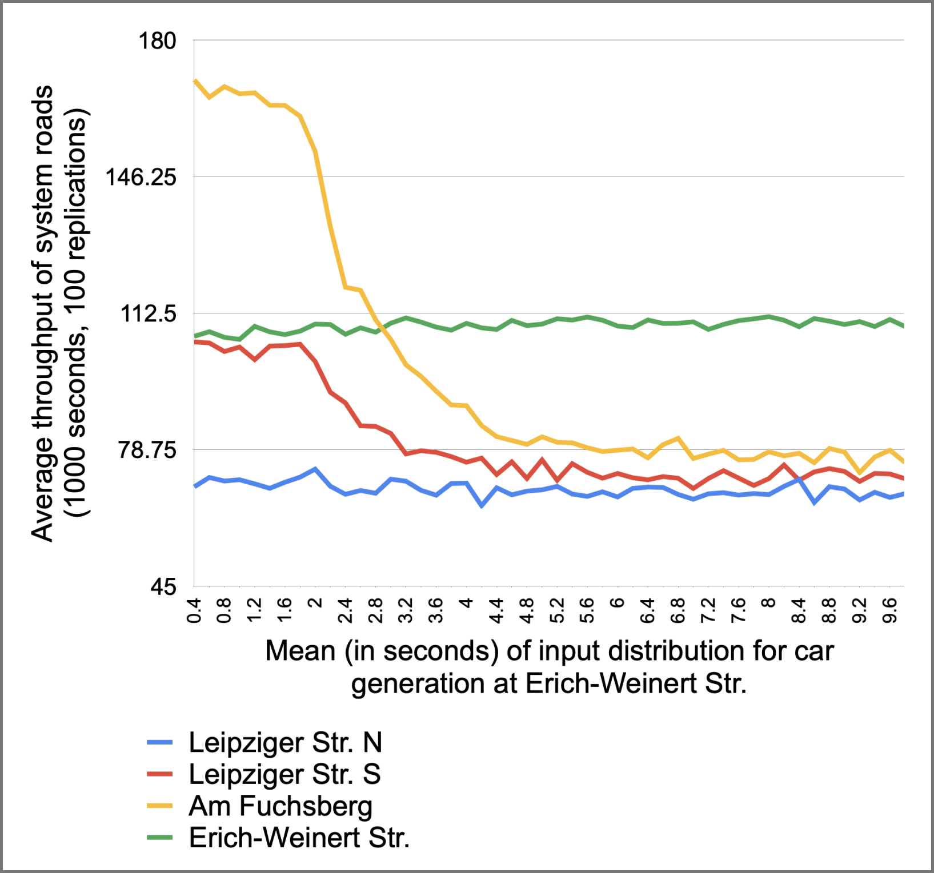
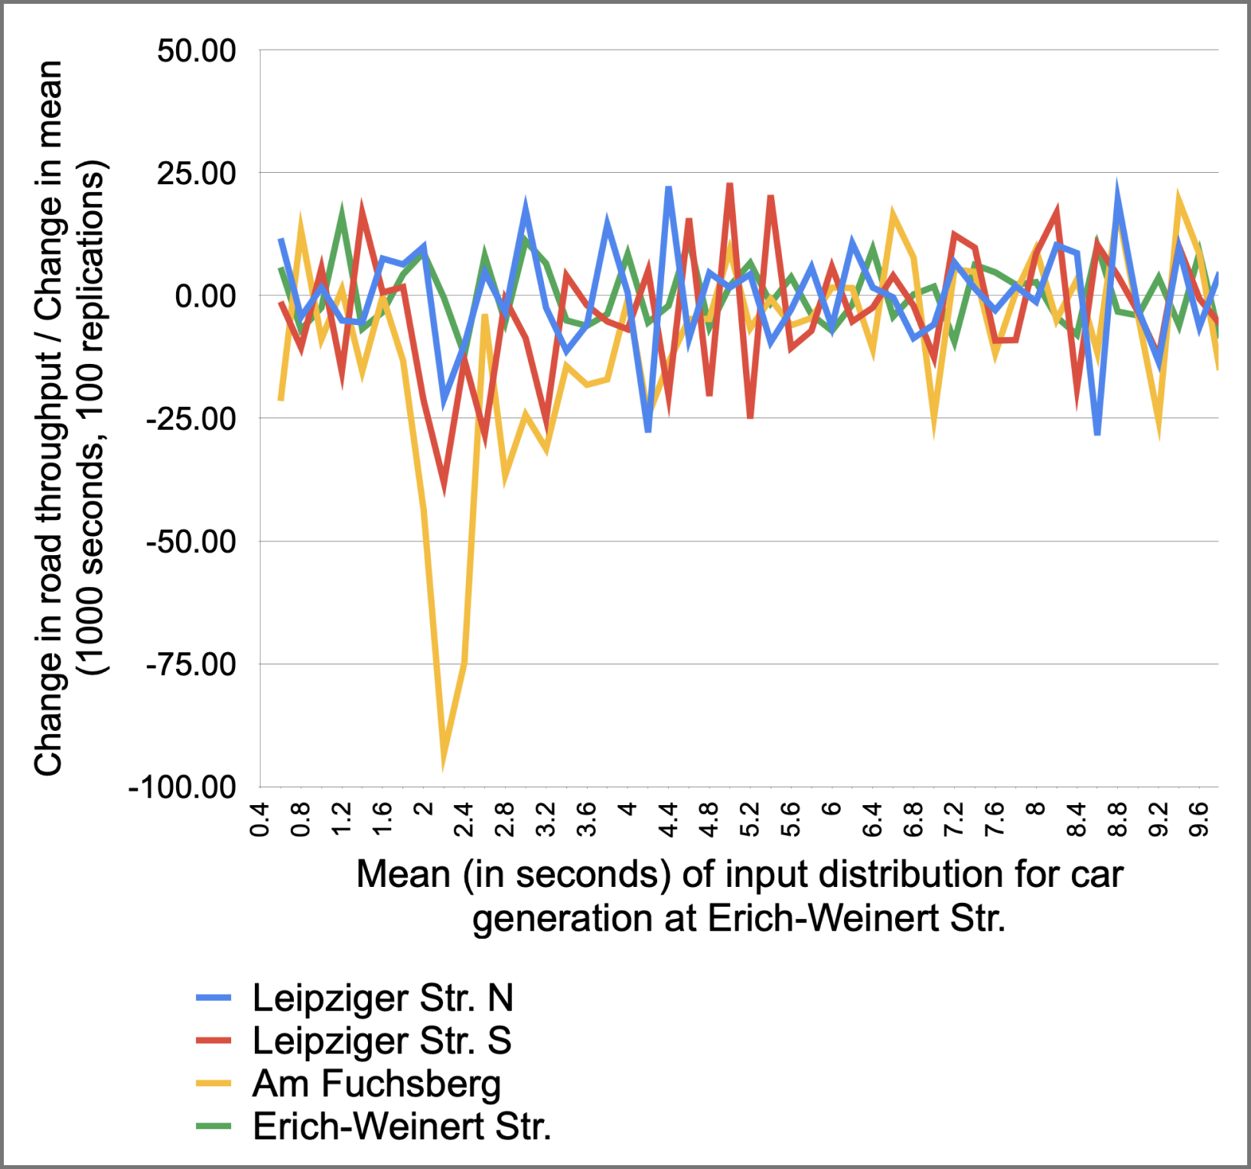
Validation and quality control
Simulation Project - Team D
Milestone #8 - Final Report

Slide 17
Experiments
Simulation Project - Team D
Milestone #8 - Final Report
#1
Open one traffic light at a time.
#4
#2
Open the traffic lights for non-overlapping traffic directions.
#3
Allow cars to move on the tram line on Leipziger Str. north
#1
#3
#2
#4
Build a bridge to connect Erich-Weinert Str. and Am Fuchsberg
#5
Build a free lane for cars turning from Leipziger Str. south into Erich-Weinert Str.
Team presentation
Planning
Conceptual model
Data analysis
Simulation program
Validation
Experiments
Final report

Slide 18
Experiments
Simulation Project - Team D
Milestone #8 - Final Report
#1
Open one traffic light at a time.
Phase 3, 4
#2
Open the traffic lights for non-overlapping traffic directions.
Phase 1, 2
Allow cars to move on the tram line on Leipziger Str. north
Phase 1, 2
#3
#4
Build a bridge to connect Erich-Weinert Str. and Am Fuchsberg
Phase 3, 4
#5
Build a free lane for cars turning from Leipziger Str. south into Erich-Weinert Str.
Team presentation
Planning
Conceptual model
Data analysis
Simulation program
Validation
Experiments
Final report

Slide 19
Experiments
Simulation Project - Team D
Milestone #8 - Final Report
#1
Open one traffic light at a time.
#2
Open the traffic lights for non-overlapping traffic directions.
#3
Allow cars to move on the tram line on Leipziger Str. north
#4
Build a bridge to connect Erich-Weinert Str. and Am Fuchsberg
#5
Build a free lane for cars turning from Leipziger Str. south into Erich-Weinert Str.
Team presentation
Planning
Conceptual model
Data analysis
Simulation program
Validation
Experiments
Final report

Slide 20
Experiments
Simulation Project - Team D
Milestone #8 - Final Report
#1
Open one traffic light at a time.
#2
Open the traffic lights for non-overlapping traffic directions.
#3
Allow cars to move on the tram line on Leipziger Str. north
#4
Build a bridge to connect Erich-Weinert Str. and Am Fuchsberg
#5
Build a free lane for cars turning from Leipziger Str. south into Erich-Weinert Str.
Team presentation
Planning
Conceptual model
Data analysis
Simulation program
Validation
Experiments
Final report

Slide 21
Experiments
Simulation Project - Team D
Milestone #8 - Final Report
#1
Open one traffic light at a time.
#2
Open the traffic lights for non-overlapping traffic directions.
#3
Allow cars to move on the tram line on Leipziger Str. north
#4
Build a bridge to connect Erich-Weinert Str. and Am Fuchsberg
#5
Build a free lane for cars turning from Leipziger Str. south into Erich-Weinert Str.
Team presentation
Planning
Conceptual model
Data analysis
Simulation program
Validation
Experiments
Final report

Slide 22
02
Experiments
Simulation Project - Team D
Milestone #8 - Final Report
Experiments performed, their results, and their statistical significance

Slide 23
Experiment goals
Simulation Project - Team D
Milestone #8 - Final Report
Dimension | Variables of interest | Desired goal
Traffic conditions | Throughput: amount of cars passing through the system in one hour.
Traffic conditions | Time in model: time, in seconds, that a vehicle stays within the model.
Traffic conditions | Queue length: amount of cars waiting in the individual lanes of each road.
Safety | Stop count: number of vehicle stops within the main intersection.

Slide 24



Experiment result overview
Simulation Project - Team D
Milestone #8 - Final Report
Experiments
Variable of interest | Desired goal
Throughput | Maximize
Time in model | Minimize
Queue length | Minimize
Stop count within the main intersection | Minimize
Experiment 1 - One road | Experiment 2 - Opposite | Experiment 3 - Tram lane | Experiment 4 - Bridge | Experiment 5 - Right lane

Slide 25
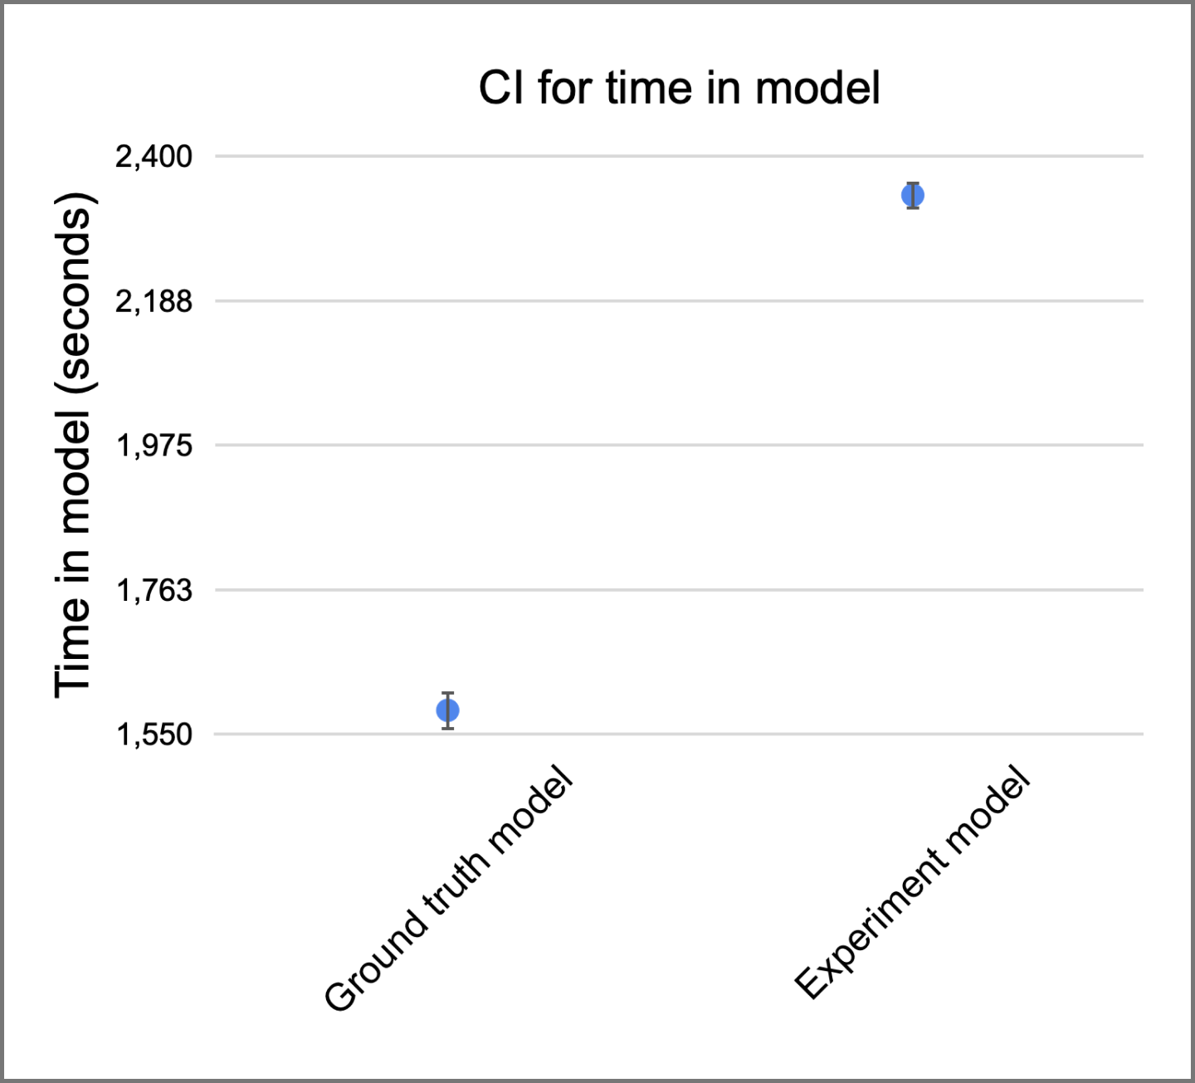
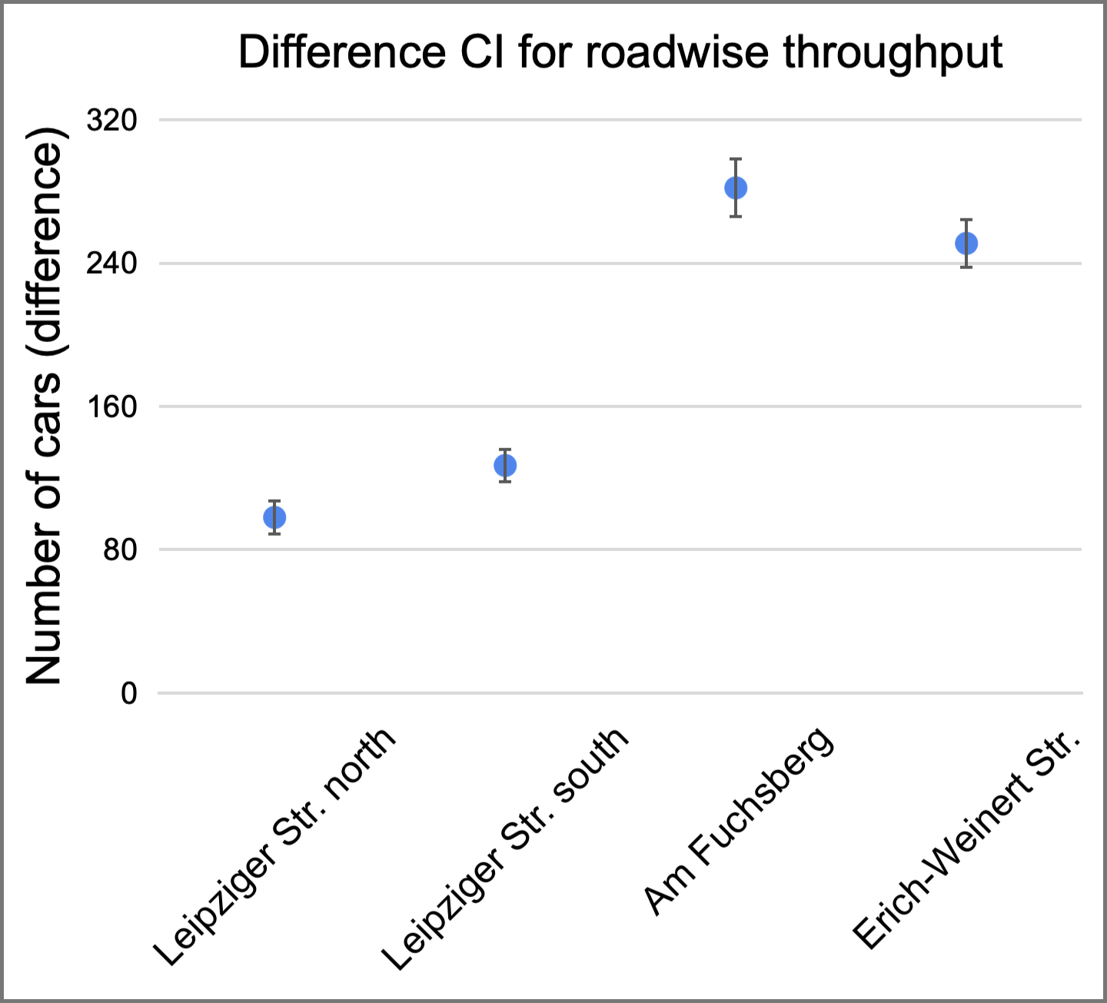
Experiment 4: Detailed analysis
Simulation Project - Team D
Milestone #8 - Final Report
CI Max: 299
Mean: 282
CI Min: 265
CI Max: 2363
Mean: 2343
CI Min: 2322
CI Max: 108
Mean: 98
CI Min: 88
CI Max: 265
Mean: 251
CI Min: 237
CI Max: 1613
Mean: 1585
CI Min: 1556
CI Max: 137
Mean: 127
CI Min: 117

Slide 26
03
Recommendations
Simulation Project - Team D
Milestone #8 - Final Report
Our recommendations to the City of Magdeburg, limitations, and trade-offs

Slide 27

Recommendations overview
Simulation Project - Team D
Milestone #8 - Final Report
Additional dimension: implementation costs
Recommendation | Variables of interest
 | Cost | Traffic condition | Safety metrics
Open opposite, non-overlapping traffic signals for cars.
Allow cars to go on the blocked tram lane in Leipziger Str. North.
Make a bridge or underpass for cars going straight in between Am Fuchsberg and Erich-Weinert Str.

Slide 28
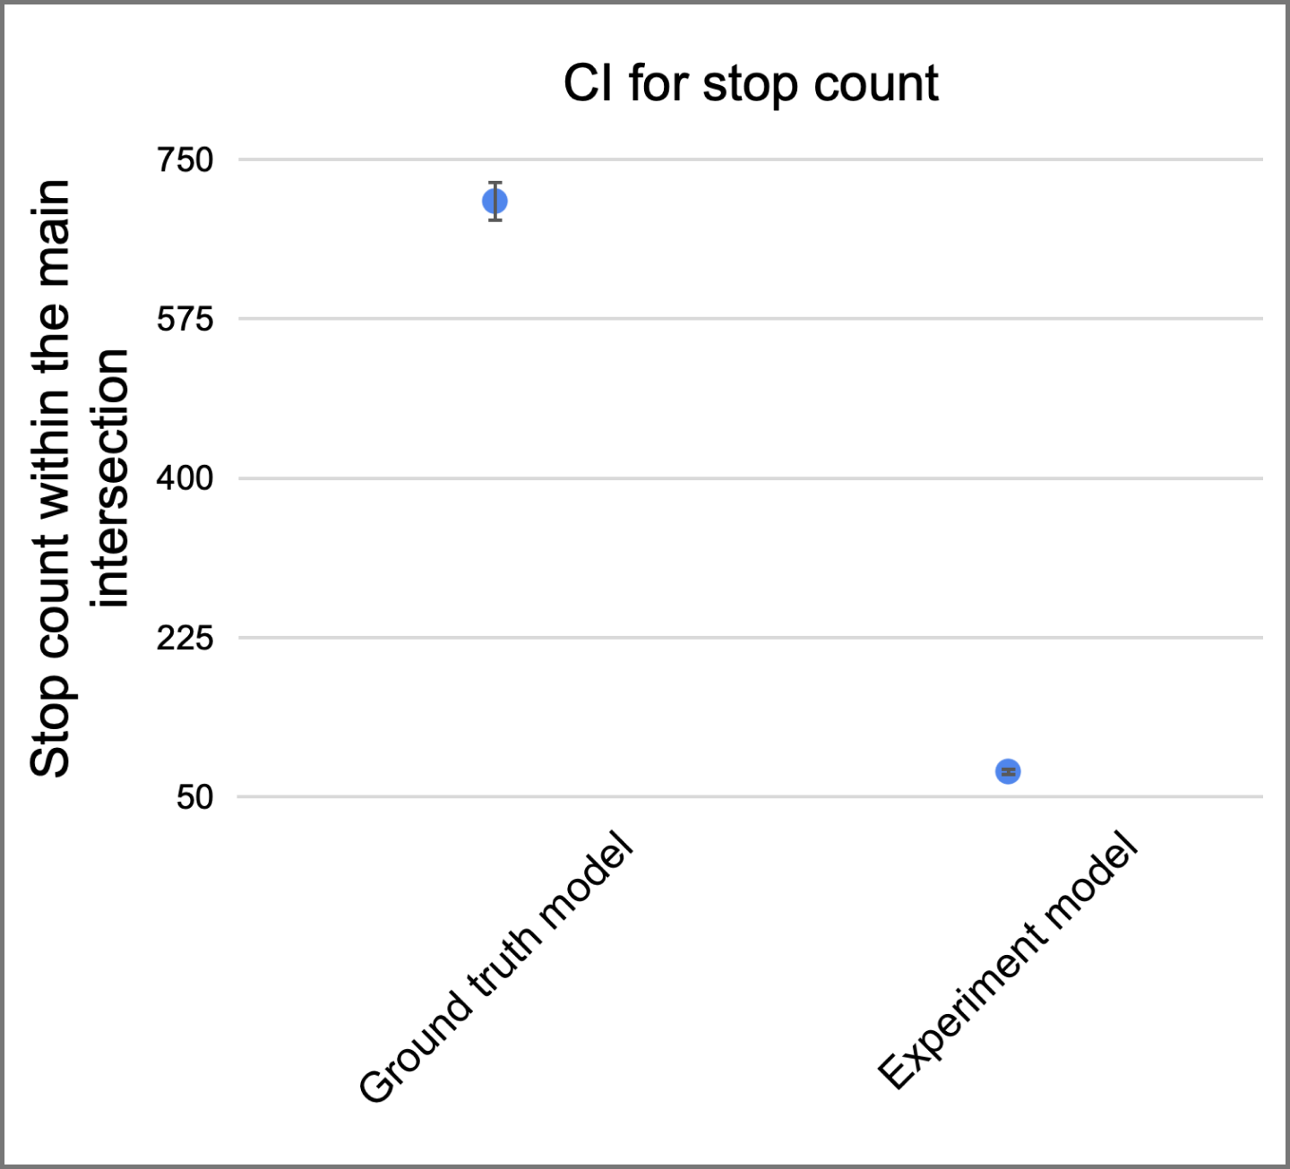
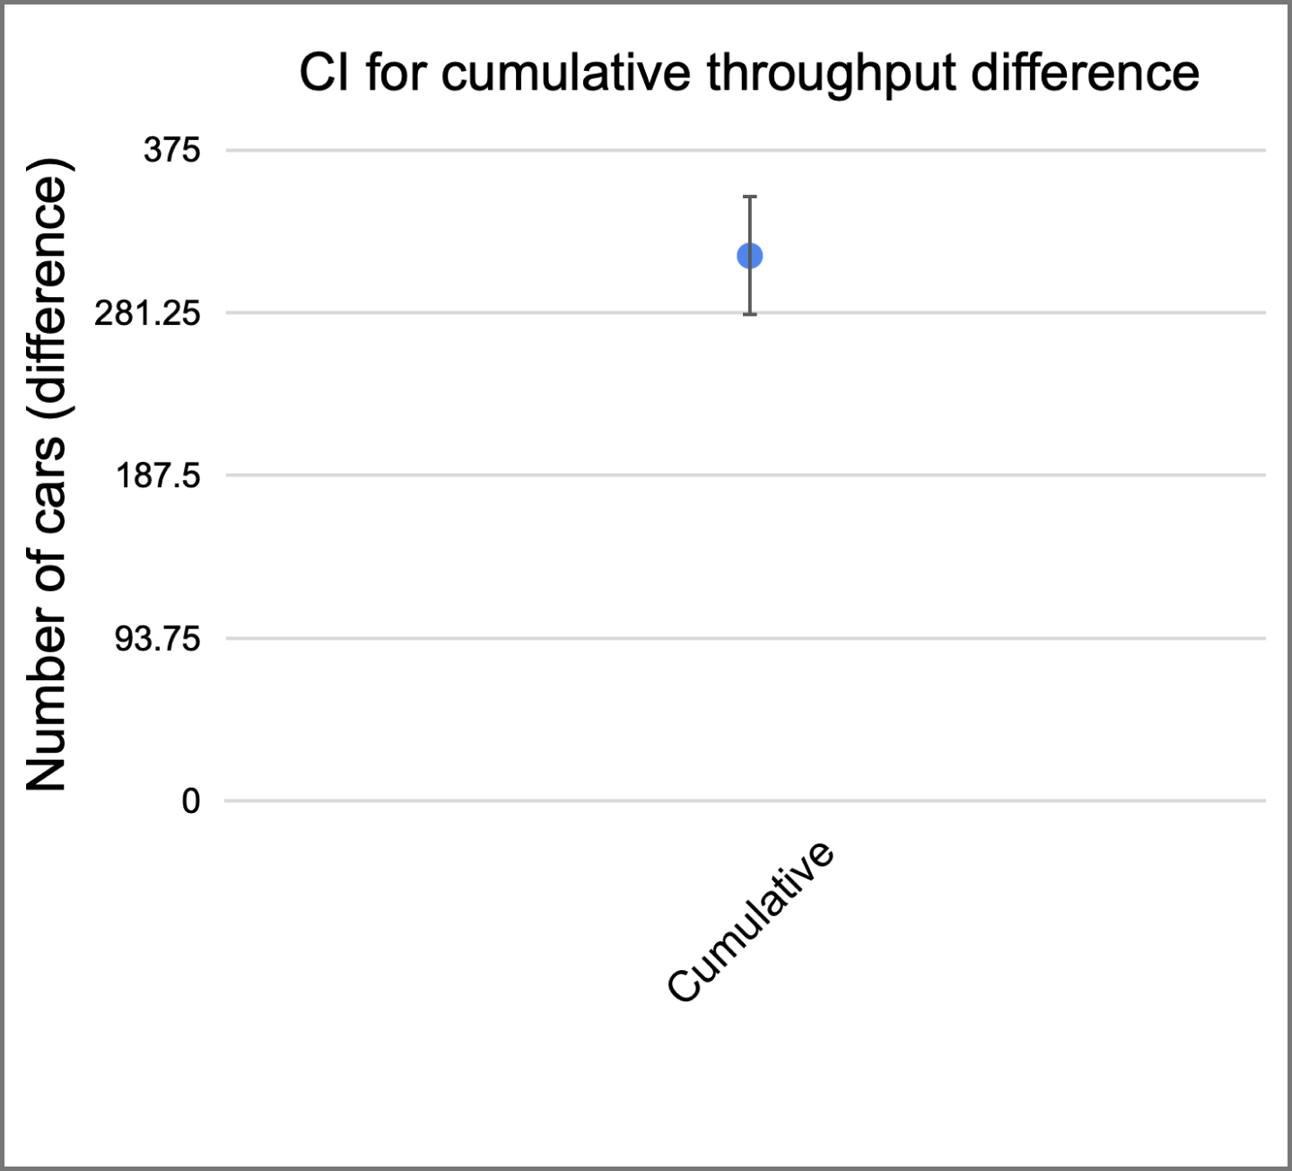
Analysis of combined model
Simulation Project - Team D
Milestone #8 - Final Report
CI Max: 726
Mean: 704
CI Min: 681
CI Max: 349
Mean: 314
CI Min: 279
CI Max: 82
Mean: 78
CI Min: 73

Slide 29
Limitations and trade-offs
Simulation Project - Team D
Milestone #8 - Final Report
#1
Atypical traffic conditions due to COVID-19.
#2
No output data available in the available datasets.
#3
Differences between previous team’s and Magdeburg’s datasets.
#4
Safety and traffic conditions are two opposite metrics.
#5
AnyLogic’s limitations of the underlying Road Traffic Library.

Slide 30
04
Overview of spending
Simulation Project - Team D
Milestone #8 - Final Report
Cost overview and statement of profit

Slide 31
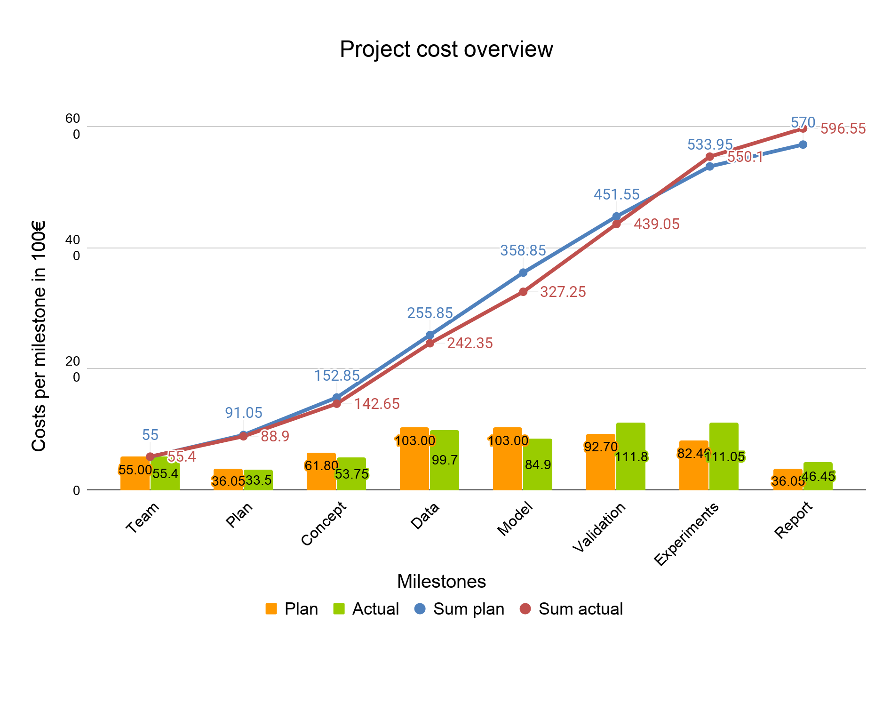
Simulation Project - Team D
Milestone #8 - Final Report

Slide 32
05
Lessons learned
Simulation Project - Team D
Milestone #8 - Final Report
What we, as a team, have learned throughout the execution of the simulation project

Slide 33
Lessons learned
Simulation Project - Team D
Milestone #8 - Final Report
#1
Team work requires coordination and trust on the quality of the work of our teammates.
#2
Each of us should be open for discussion and willing to accept suggestions from others.
#3
Real-world scenarios often do not provide “textbook” solutions, raising the need for trade-offs and compromises.
#4
Quantitative justification and statistical significance are more important than intuition.
#5
With enough commitment, we can deliver a very high quality work which can bring real value to our customers.

Slide 34
06
Thank you!
Simulation Project - Team D
Milestone #8 - Final Report
Questions?

